Slide 1
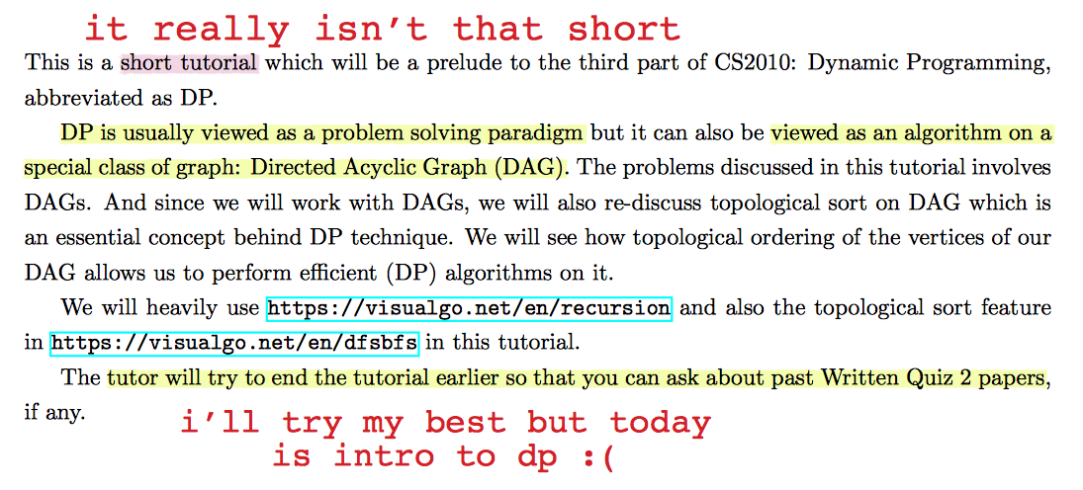

Slide 2
Dynamic Programming
Suyash Shekhar

Slide 3
What’s so dynamic about dynamic programming?

Slide 4
Bellman pioneered this paradigm. But, this was actually mathematical research. Back in his day, the then secretary of defense was paranoid of the words Research and Math.
So to blur things a bit, he called it Dynamic Programming, however there's nothing 'dynamic' about it.

Slide 5
lets finish up the DAG bits first

Slide 6
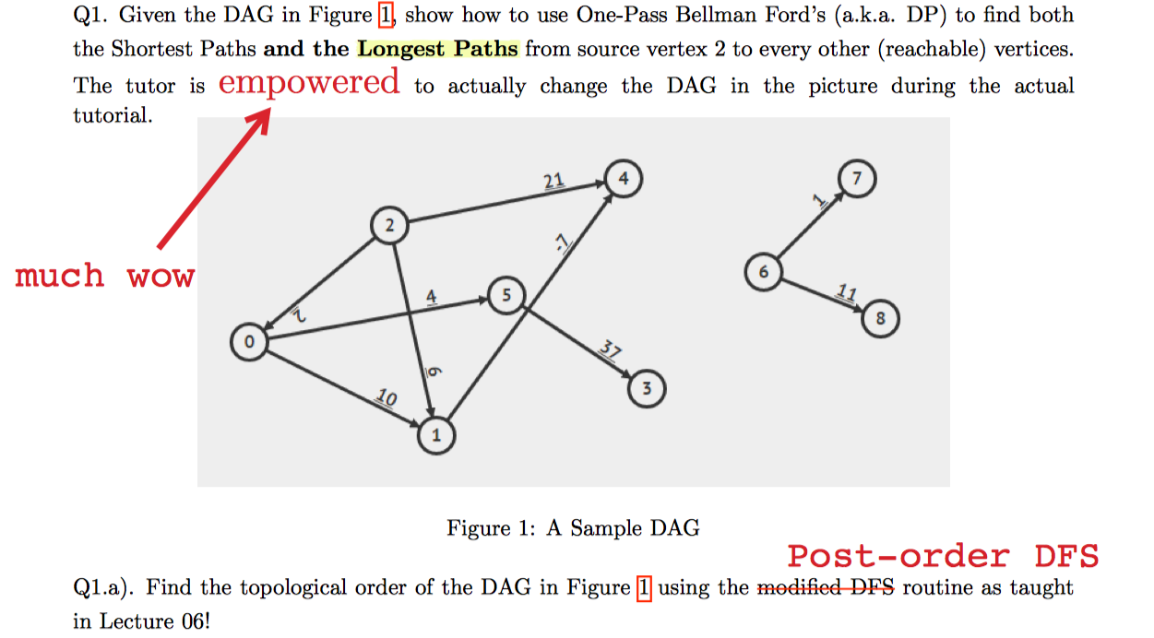

Slide 7
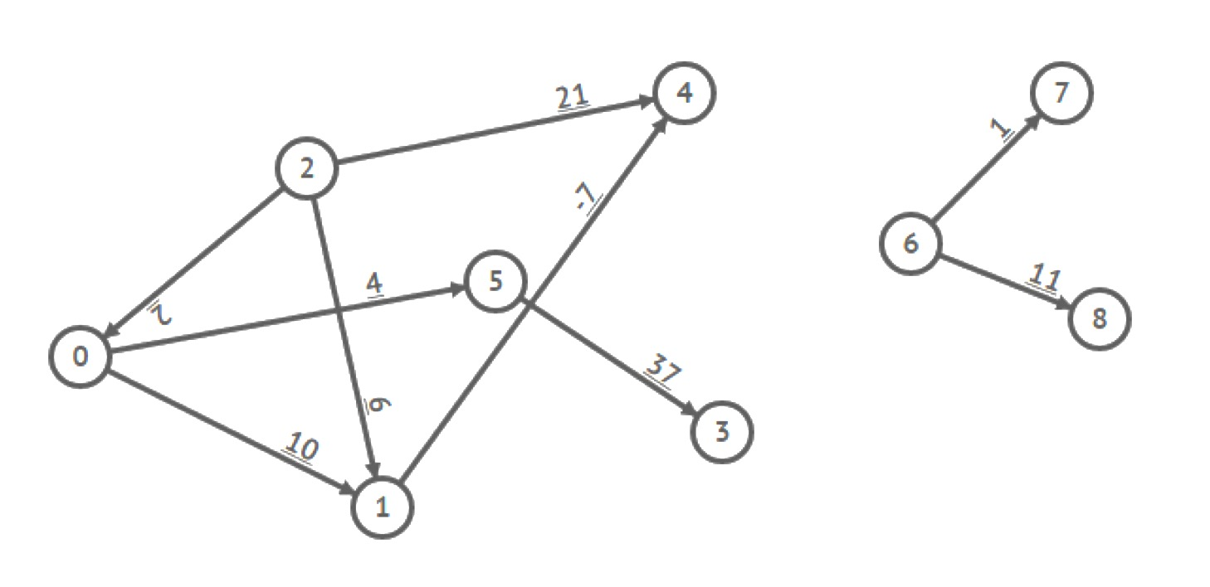
find topological ordering
“modifed DFS” visits smaller vertex first (in CS2010)

Slide 8
find topological ordering
{6,8,7,2,0,5,3,1,4}

Slide 9
find SSSP from 2
{6,8,7,2,0,5,3,1,4}

Slide 10
find topological ordering
{6,8,7,2,0,5,3,1,4}

Slide 11
Longest Path Problem SSLP?

Slide 12
NP-COMPLETE

Slide 13
No Optimal Sub-Structure

Slide 14
but relaxing in topological order works for a DAG

Slide 15
find SSSP from 2
{6,8,7,2,0,5,3,1,4}

Slide 16
Topological Ordering in not Unique

Slide 17
So how many can be there in the worst case?

Slide 18
Find all Topological Orderings of a Graph

Slide 19
Number all possible orderings: O(V!) Check each of them: O(E) for each
O(V! x E)

Slide 20
uncomprehensible words coming at you in 3.. 2.. 1..

Slide 21
Dynamic Programming

Slide 22
usually used for optimization problems

Slide 23
Dynamic Programming
optimal sub-structure
overlapping sub-problems

Slide 24
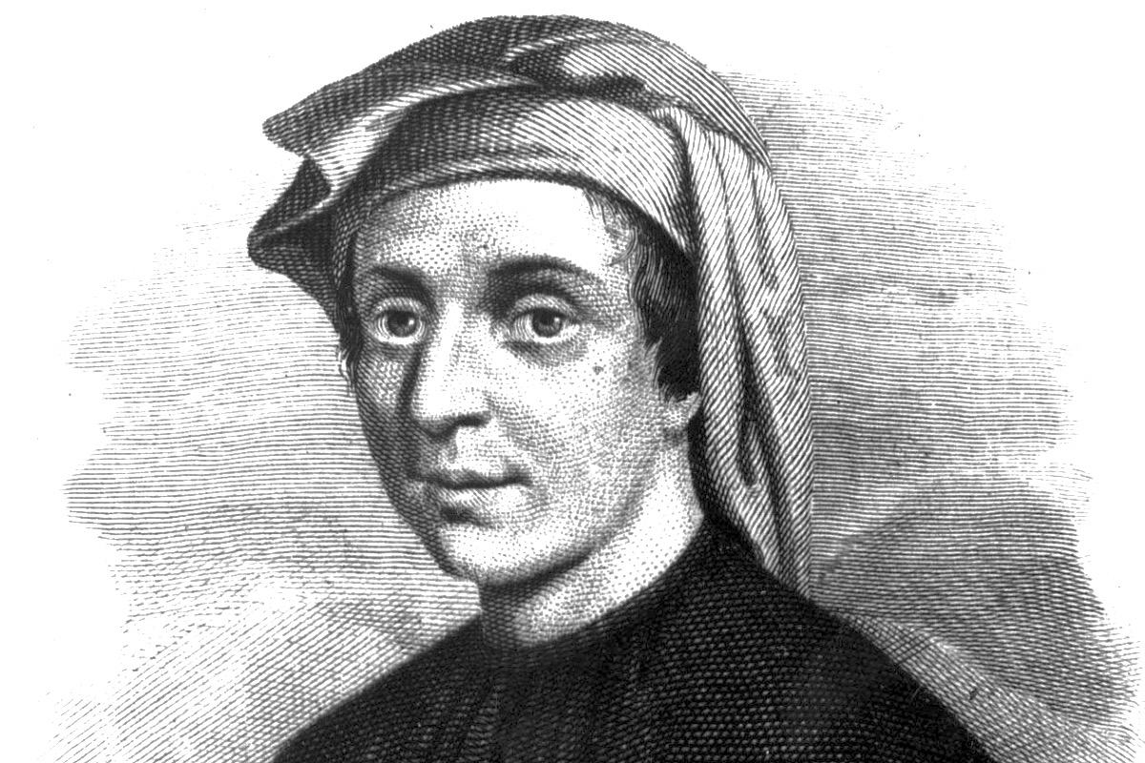
Fibonacci
fib(n):
if n in [0, 1]:
return 1
else:
return fib(n-1) + fib(n-2)

Slide 25
Memo-Fibonacci
mem = HashMap()
mem.put(0, 1)
mem.put(1, 1)
mem_fib(n):
if mem.get(n) != null:
return mem.get(n)
else:
return mem_fib (n-1) + mem_fib (n-2)

Slide 26
Bottom-Up -Fibonacci
mem = HashMap()
mem.put(0, 1)
mem.put(1, 1)
mem_fib(n):
for i in range (2, n):
mem.put(i, mem.get(i-1), mem.get(i-2))
return mem.get(n)

Slide 27
Bottom-up Approach
Solving sub-problems in Topological Order on a Dependency DAG

Slide 28
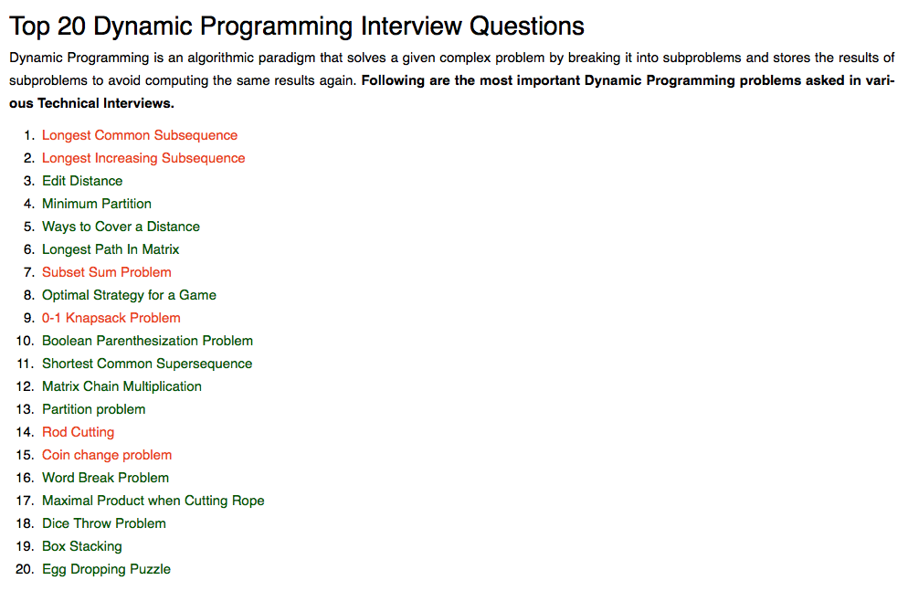
(not sponsored)

Slide 29
LONGEST INCREASING SUBSEQUENCE

Slide 30
LONGEST INCREASING SUBSEQUENCE
[1,3,2,4,6,5,7,9]

Slide 31
LONGEST INCREASING SUBSEQUENCE
[1,3,2,4,6,5,7,9]

Slide 32
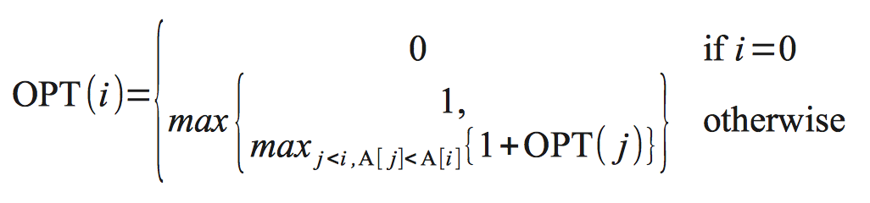
LONGEST INCREASING SUBSEQUENCE
[1,3,2,4,6,5,7,9]

Slide 33
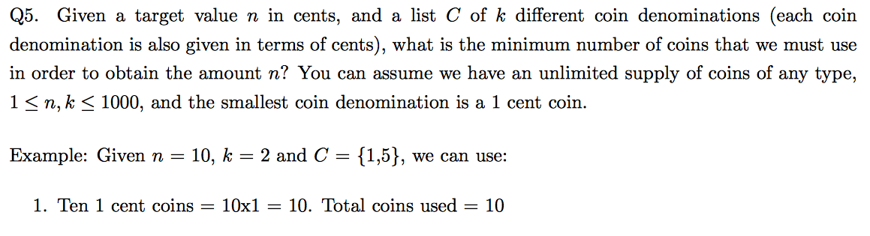
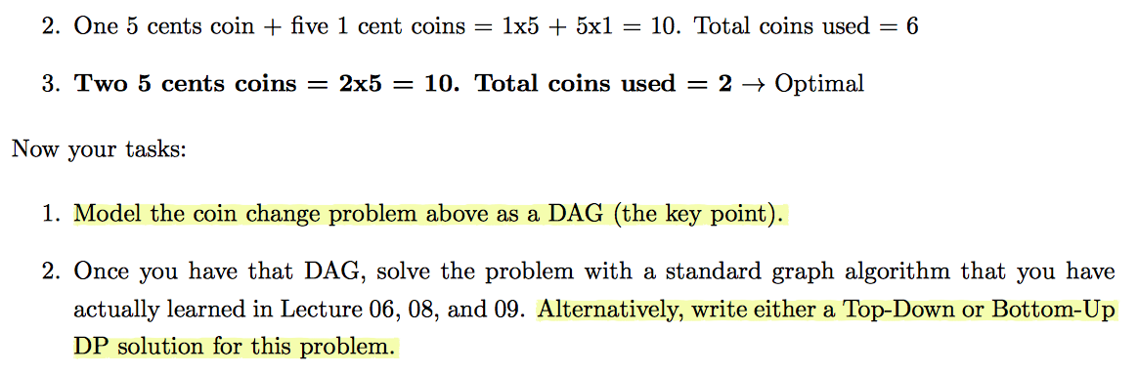

Slide 34
GREEDY?

Slide 35
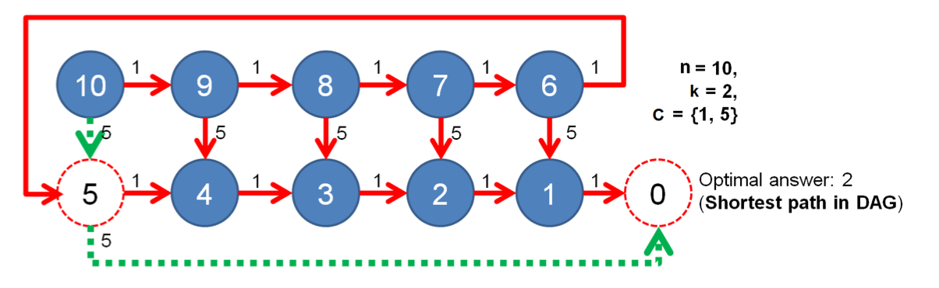
States and Transitions??

Slide 36
SSSP on Unweighted DAG = BFS

Slide 38
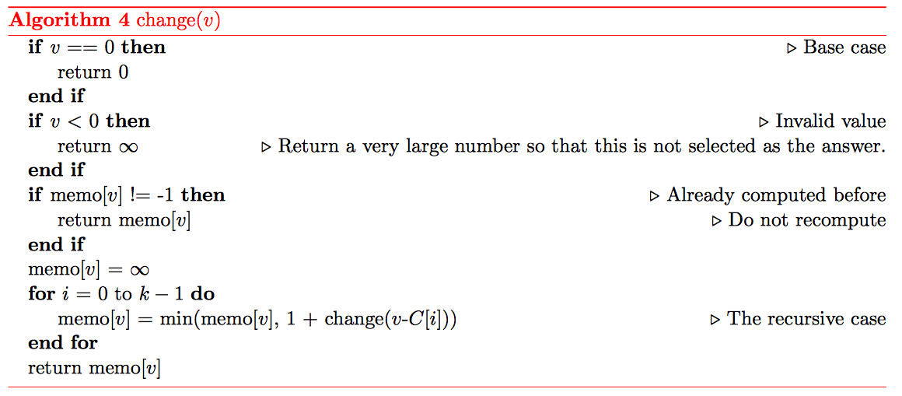

Slide 39
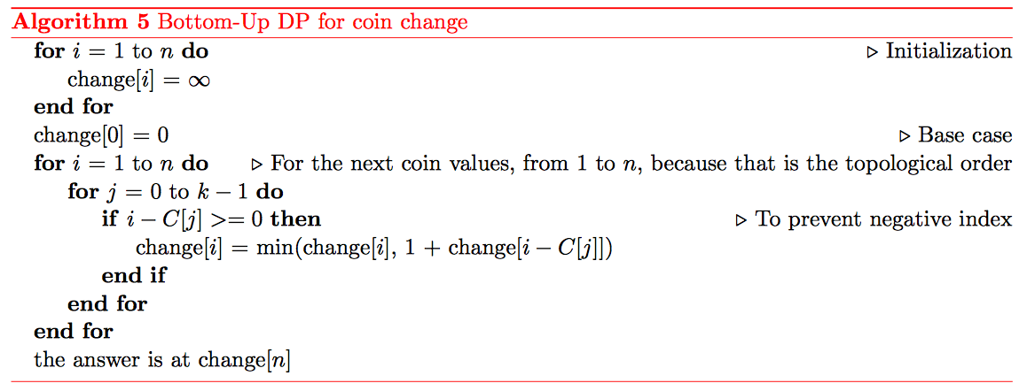

Slide 40
BYE

